Slide 1
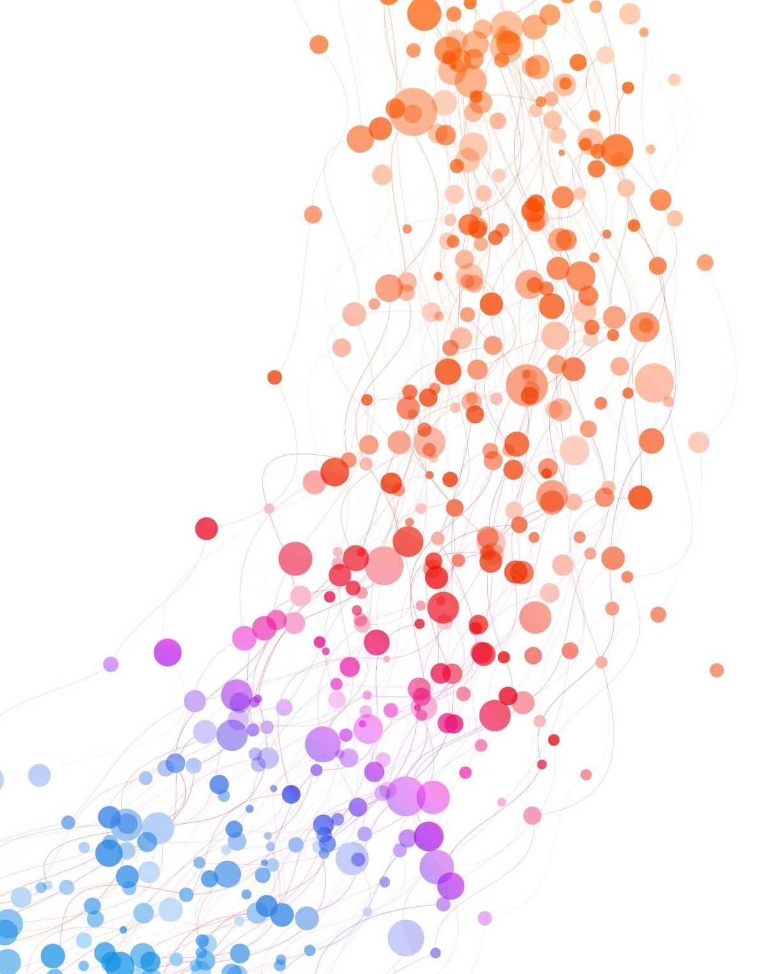
UNIT-III Profit Planning Techniques
Entrepreneurship and Project Management

Slide 2
Profit Planning Techniques
Break Even Analysis

Slide 3
Break Even Analysis
BEA is defined as, “an Analysis of costs and their possible impact on revenues and volume of firm.” so it is called as cost-volume-profit analysis.
It is an Analytical technique used to study the relationship between total Costs, Total Revenues and Total Profits. It is the analysis of BEP.
The decision maker has to assess the relative change in profit with a given change in sales, price and cost with the help of “Break even Analysis”.
BEP is defined as No Profit – No Loss point. It is important because it denotes the minimum volume of production to be produced to avoid loss. It is a technique for profit planning and control, so it is a valuable managerial tool.
Profit is the ultimate aim of a firm.
TR-TC=Profit, TC=FC+VC

Slide 4
Break Even Analysis
Important Terminology used in BEA
Fixed cost – It remains fixed in short run even output is changed.
Variable cost – it varies along with output.
Total cost – it is the sum of fixed cost and variable cost.
Total Revenue – the total sale proceeds. (S.P per unit X No. of units sold)
Contribution – S.P. per unit – V.C. Per unit
Profit – contribution-fixed cost
Contribution ratio – it is the ratio between contribution per unit & S.P. Per unit
Margin of safety – units – Actual sales in units – break even sales in units
Sales value- Actual sales in rupees – break even sales in rupees
P/V Ratio – the ration Between contribution and sales C/S
Angel of incidence – the angel formed where TC curve cuts TR Curve.

Slide 5
Break Even Analysis
Formulaes:
Selling Price = Fixed cost + Variable cost + Profit
Selling Price – Variable Cost = Fixed cost + Profit
Contribution = Fixed cost + Profit
Contribution per unit = Selling price per unit – Variable cost per unit.
BEP in units:
BEP = Fixed cost/Contribution margin per unit
BEP in value:
BEP = Fixed costs/ contribution margin ratio
Contribution Margin ratio = Contribution per unit/ Selling price per unit.

Slide 6
Break Even Analysis
Formulaes:
If per unit data is not given then
BEP = Fixed costs/ PV ratio
Margin of Safety = Net profit/ PV ratio.
PV Ratio = (Contribution / Sales) * 100.
To ascertain the volume of sales required to achieve a targeted amount of profit:
Volume of sales to attain a targeted profit = (Fixed costs+Targeted profit)/Contribution

Slide 7
Break Even Analysis
Assumptions underlying break even analysis
Costs can be perfectly classified into fixed and variable costs.
All the goods produced are sold. There is no closing stock
Selling price doesn’t change with volume changes. It remains fixed. It doesn’t consider the price discounts.
There is only one product available for sale. In case of multi product firms the product mix does not change.
It assumes no improvement in technology and labour efficiency.
It assumes constant rate of increase in variable cost.

Slide 8
Break Even Analysis
Significance/ importance
It is a valuable tool to ascertain the profit on a particular level of sales volume or a given capacity of production.
To calculate sales required to earn a particular desired level of profit.
To compare the product lines sales area methods of sale for individual company.
To compare the efficiency of the different firms.
To decide whether to add a particular product to the existing product line or drop one from it.
To decide to “Make or Buy” a given component or spare part.
To decide what promotion mix will yield optimum sales.
To assess the impact of changes in fixed cost, variable cost or selling price on BEP and profits during a given period.

Slide 9
Limitations of BEA
BEP is based on Fixed cost, variable cost and Total Revenue. A change in one variable is going to affect the BEP.
All costs cannot be classified as only fixed and variable. Some are semi fixed or semi variable.
In case of multi product firm, a single chart cannot be of any use. Series of charts have to be made use of.
It is based on fixed cost concept and hence holds good only in short run.
TC and TR lines are not always straight. The quantity and price discounts are the usual phenomena affecting the TR line.
Where the business conditions are volatile, BEP cannot give stable results.
Often the inputs prices increases overtime and generally it is avoided because of the complexity in the analysis.
It ignores selling costs, concentration on production costs.

Slide 10
Problems
A firm has a fixed cost of Rs.10,000/- , Selling price per unit is Rs.5/-, Variable cost per unit is Rs.3/-.
Determine BEP in terms of sales value and volume.
Calculate MOS considering that the actual production is 8000 units.

Slide 11
A high Tech Rail can carry a Max. Of 36,000 passengers per annum at a fare of Rs.400. The Variable cost per passenger is Rs.150/-, Fixed cost are 25,00,000 per year..
Find the BEP in terms of Number of Passengers and Also in terms of Fare collections.

Slide 12
Srikanth Enterprises deals in the supply of hardware parts of a computer. The following cost data is available for two successive periods.
Determine BEP, MOS
 | Year 1 | Year 2
Sales | 50,000 | 1,20,000
Fixed Cost | 10,000 | 20,000
Variable Cost | 30,000 | 60,000

Slide 13
A Lathe Workshop owner uses 150 units of a certain spare part. He buys this from the market for Rs.250. The same can be manufactured in his workshop with a fixed cost of Rs.40000. And a variable cost of Rs.50.
Do you suggest him to Make or Buy from the market.
Is it possible that he can sell 500 units of the same spare part to other Lathe workshops in the town.

Slide 14
A firm has a fixed cost of Rs.50,000, S.P. Per unit is Rs.50, V.C. Per unit is Rs.25, Level of Production = 3500 units.
Calculate BEP in Value, Volume
MOS
What is the change in BEP & MOS, if Fixed Cost increases to Rs.60000.

Slide 15
Fixed costs of a factory Rs.10,000 Per Year.
VC Rs 2
SP Rs 4
BEP =
A)If desired Profit is Rs.6000?-, what should be the target sales Volume
B)If SP is reduced from 4 to 3.60
C)If the SP is increased from 4 to 4.50

Slide 16
Fixed costs of a factory Rs.60,000 Per Year.
VC= Rs 6
SP= Rs 10
Determine BEP in Value and Volume
A) what number of units to be sold to achieve a desired Profit of Rs.10000/-
B)given an increase in V.C by Rs.2 Per Unit & Increase in F.C by Rs.10000 p.a.
C)what level of sales will achieve a profit of Rs.30000.

Slide 17
TFC=4500, TVC=7500, Total Sales=15000, units sold=5000
A) Contribution
B)BEP in Units
C)MOS
D)Calculate volume of sales to earn a profit of Rs.6000
Sales=5000 units @ Rs.20 each
VC=Rs.12 Per Unit
Fixed Cost=Rs.25000
Profit when sales are Rs.500000

Slide 18
Sales | 2000000 | Profit | 200000
Sales | 2500000 | Profit | 300000
Determine BEP

Slide 19
YEAR | SALES | PROFIT
1996 | 150000 | 20000
1997 | 170000 | 25000
The Sales Turnover and Profit during Two years were as Follows:-
You are required to calculate
A) P/V Ratio
B)The sales required to earn a profit of Rs.40000
C)The Profit made when sales are Rs.250000
D) MOS at a Profit of Rs.50000

Slide 20
YEAR | SALES | PROFIT
2000 | 160000 | 20000
2001 | 180000 | 25000
The Sales Turnover and Profit during Two years were as Follows:-
You are required to calculate
A) P/V Ratio
B)The sales required to earn a profit of Rs.50000
C)The Profit made when sales are Rs.200000

Slide 21
YEAR | SALES | PROFIT
2011 | 100000 | 40000
2012 | 150000 | 80000
The Sales Turnover and Profit during Two years were as Follows:-
You are required to calculate
A) P/V Ratio
B)MOS
C)Break Even Sales
B)The sales required to earn a profit of Rs.150000

Slide 22
The following are the present cost & output data of a Manufacturer:-
Product | Price | V C P.U. | % of Sales
DROP
Book-Cases | 60 | 40 | 30
Tables | 100 | 60 | 20
Beds | 200 | 120 | 50
ADD
Book Cases | 60 | 40 | 50
Cabinets | 160 | 60 | 10
Beds | 200 | 120 | 40
TFC=75000 Per Year
Sales=Rs.250000
TFC=75000 Per Year
Sales=Rs.260000

Slide 23
The Profit on the Present Product Line is Computed
Contribution Ratio = S.P-V.C X % Share in Total Sales
S.P

